Slide 1
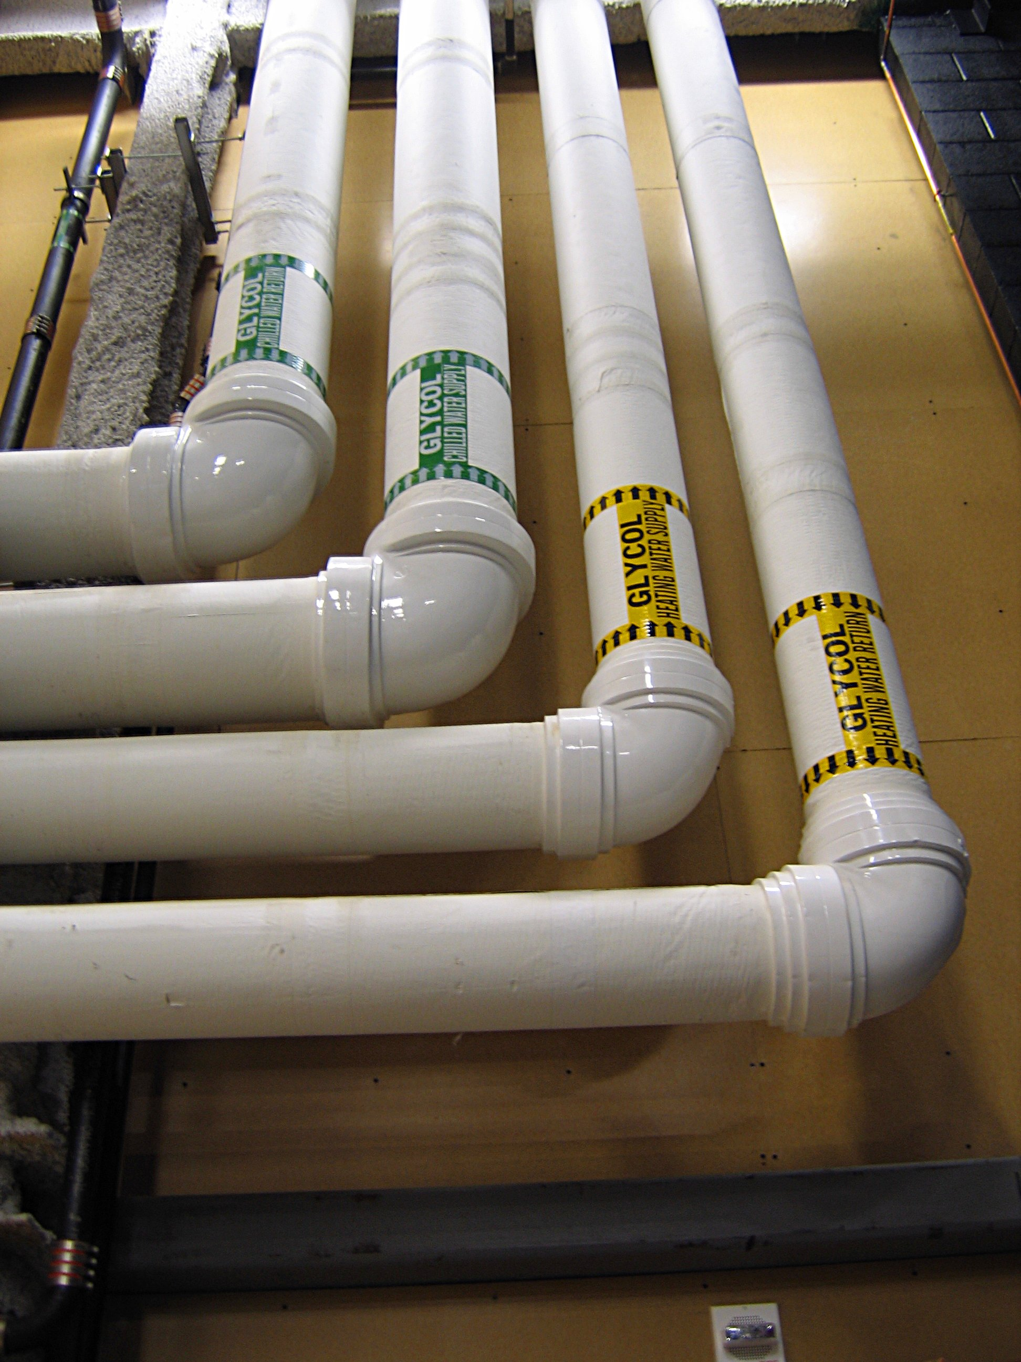
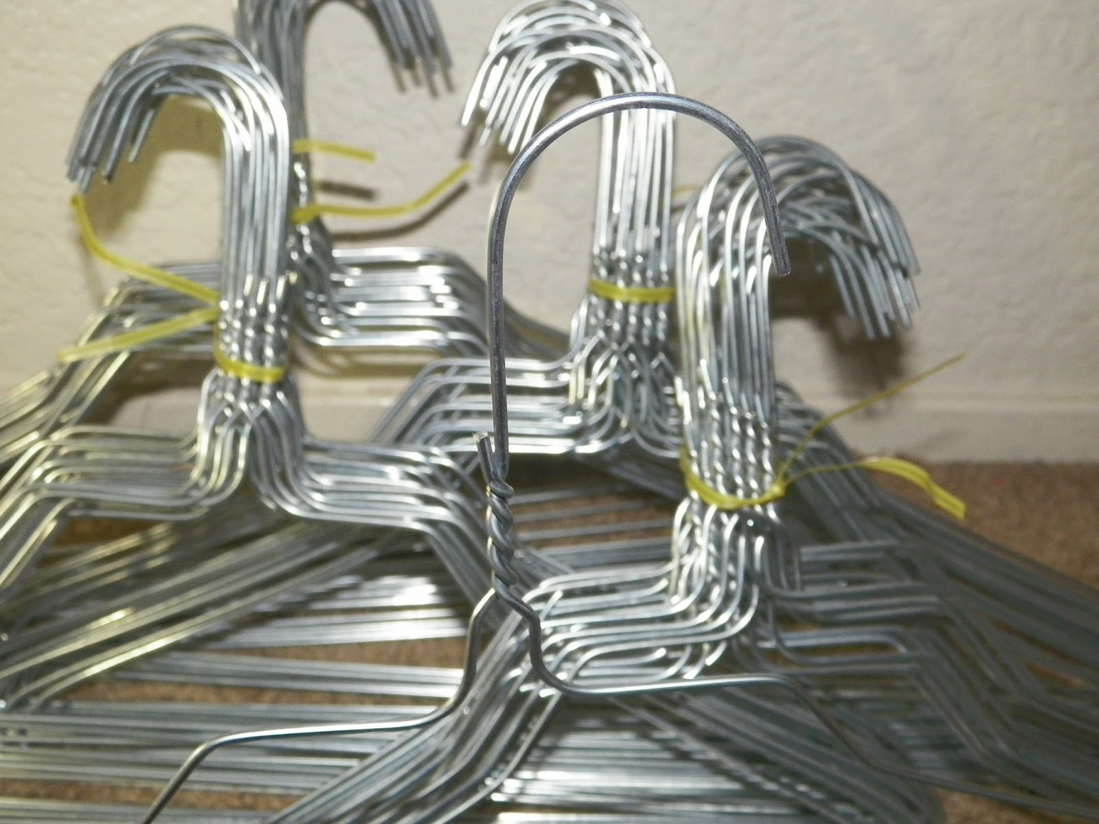
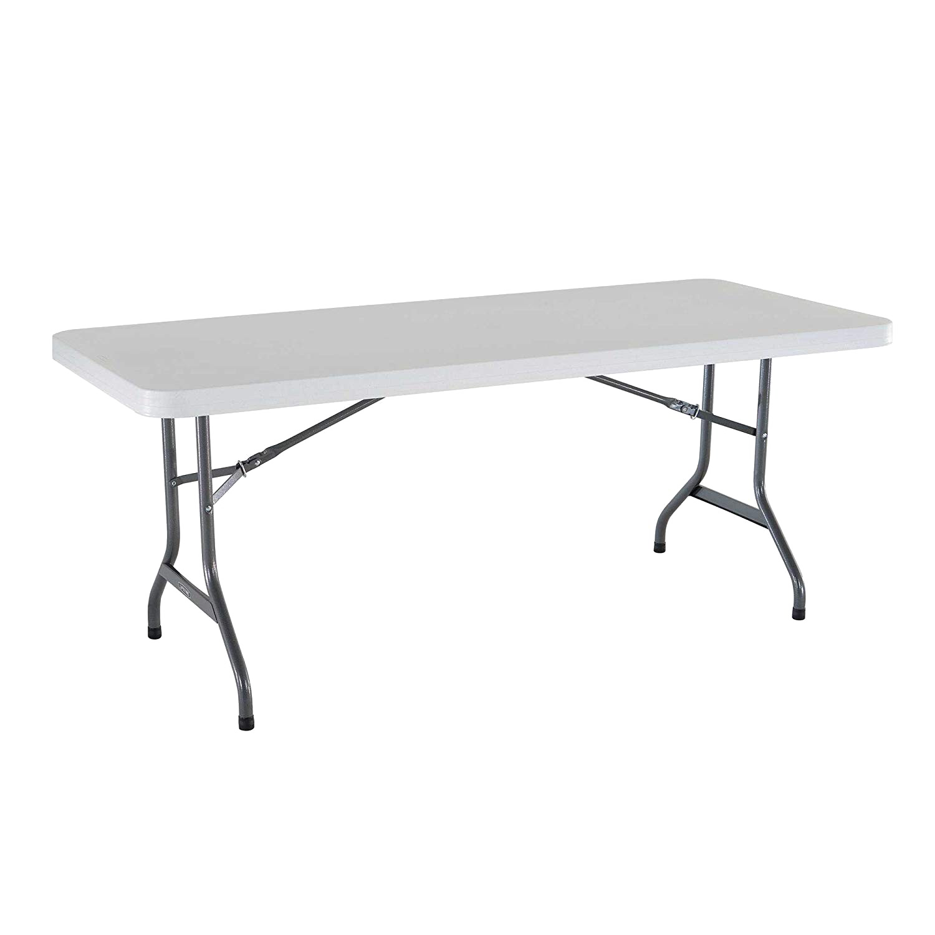
Trade Show
Wednesday September 18, 2024
THE FORUM
The Forum Events Center
109 N. Black Horse Pike, Blackwood, NJ 08012
To register for a 6 foot table
Contact: cathy@sjmca.org
Maximum 30 vendors - Setup begins at 3pm
Doors open at 5pm, Dinner at 6:30pm

